Slide 1
NoSQL

Slide 2
What is NoSQL?
NoSQL Database is a non-relational Data Management System, that does not require a fixed schema.
It avoids joins, and is easy to scale.
The major purpose of using a NoSQL database is for distributed data stores with humongous data storage needs.
NoSQL is used for Big data and real-time web apps.
For example, companies like Twitter, Facebook and Google collect terabytes of user data every single day.
NoSQL database stands for “Not Only SQL” or “Not SQL.”
Though a better term would be “NoREL”, NoSQL caught on. Carl Strozz introduced the NoSQL concept in 1998.

Slide 3
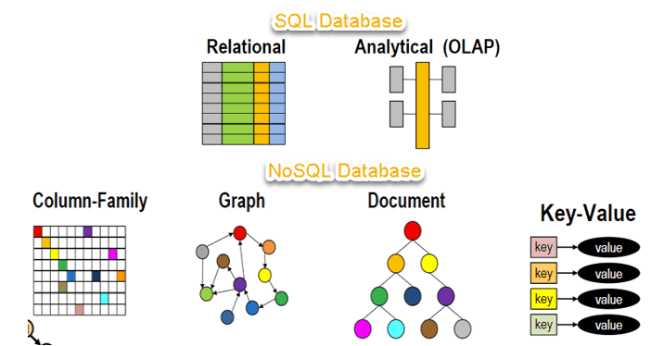
Traditional RDBMS uses SQL syntax to store and retrieve data for further insights.
Instead, a NoSQL database system encompasses a wide range of database technologies that can store structured, semi-structured, unstructured and polymorphic data.
Let’s understand about NoSQL with a diagram in this NoSQL database tutorial:

Slide 4
Why NoSQL?
The concept of NoSQL databases became popular with Internet giants like Google, Facebook, Amazon, etc. who deal with huge volumes of data.
The system response time becomes slow when you use RDBMS for massive volumes of data.
To resolve this problem, we could “scale up” our systems by upgrading our existing hardware. This process is expensive.
The alternative for this issue is to distribute database load on multiple hosts whenever the load increases.
This method is known as “scaling out.”

Slide 5
Features of NoSQL
Non-relational
NoSQL databases never follow the relational model
Never provide tables with flat fixed-column records
Work with self-contained aggregates or BLOBs
Doesn’t require object-relational mapping and data normalization
No complex features like query languages, query planners,referential integrity joins, ACID
Schema-free
NoSQL databases are either schema-free or have relaxed schemas
Do not require any sort of definition of the schema of the data
Offers heterogeneous structures of data in the same domain

Slide 6
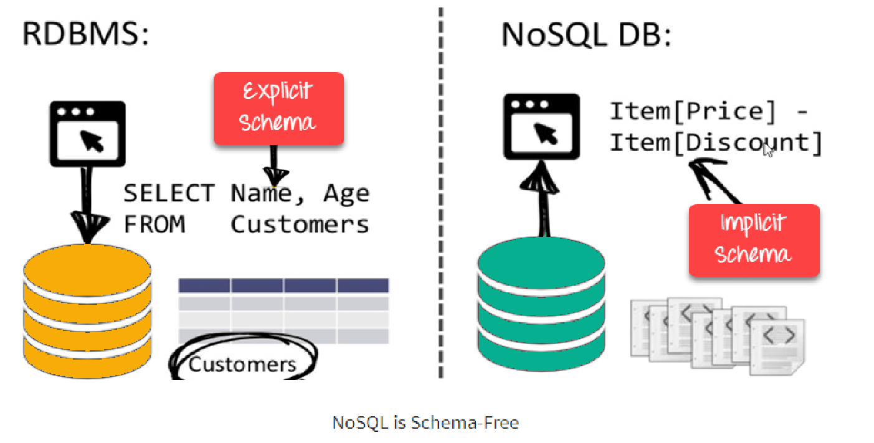

Slide 7
Simple API
Offers easy to use interfaces for storage and querying data provided
APIs allow low-level data manipulation & selection methods
Text-based protocols mostly used with HTTP REST with JSON
Mostly used no standard based NoSQL query language
Web-enabled databases running as internet-facing services
Distributed
Multiple NoSQL databases can be executed in a distributed fashion
Offers auto-scaling and fail-over capabilities
Often ACID concept can be sacrificed for scalability and throughput
Mostly no synchronous replication between distributed nodes Asynchronous Multi-Master Replication, peer-to-peer, HDFS Replication
Only providing eventual consistency
Shared Nothing Architecture.
This enables less coordination and higher distribution.

Slide 8
Types of NoSQL Databases
NoSQL Databases are mainly categorized into four types: Key-value pair, Column-oriented, Graph-based and Document-oriented.
Every category has its unique attributes and limitations.
None of the above-specified database is better to solve all the problems.
Users should select the database based on their product needs.
Types of NoSQL Databases:
Key-value Pair Based
Column-oriented Graph
Graphs based
Document-oriented

Slide 9
NoSQL Data Architecture Patterns
Architecture Pattern is a logical way of categorizing data that will be stored on the Database.
NoSQL is a type of database which helps to perform operations on big data and store it in a valid format.
It is widely used because of its flexibility and a wide variety of services.
Architecture Patterns of NoSQL:
The data is stored in NoSQL in any of the following four data architecture patterns.
1. Key-Value Store Database
2. Column Store Database
3. Document Database
4. Graph Database

Slide 10
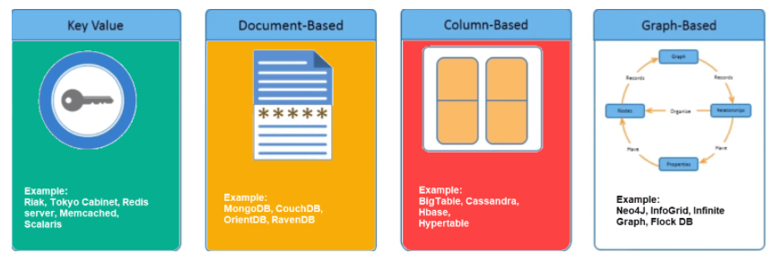

Slide 11
Key Value Pair Based
Data is stored in key/value pairs.
It is designed in such a way to handle lots of data and heavy load.
Key-value pair storage databases store data as a hash table where each key is unique, and the value can be a JSON, BLOB(Binary Large Objects), string, etc.

Slide 12
1. Key-Value Store Database:
This model is one of the most basic models of NoSQL databases.
As the name suggests, the data is stored in form of Key-Value Pairs.
The key is usually a sequence of strings, integers or characters but can also be a more advanced data type.
The value is typically linked or co-related to the key.
The key-value pair storage databases generally store data as a hash table where each key is unique.
The value can be of any type (JSON, BLOB(Binary Large Object), strings, etc).
This type of pattern is usually used in shopping websites or e-commerce applications.

Slide 13

Advantages:
Can handle large amounts of data and heavy load,
Easy retrieval of data by keys.
Limitations:
Complex queries may attempt to involve multiple key-value pairs which may delay performance.
Data can be involving many-to-many relationships which may collide.
Examples:
DynamoDB
Berkeley DB

Slide 14
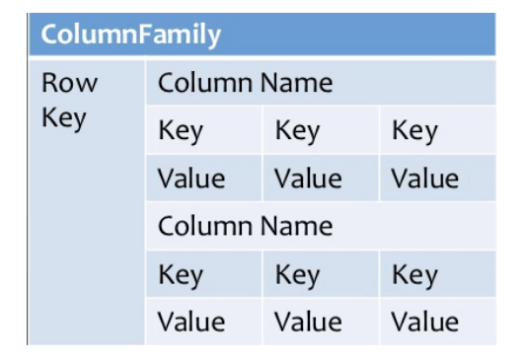
Column-based
Column-oriented databases work on columns and are based on BigTable paper by Google.
Every column is treated separately.
Values of single column databases are stored contiguously.
They deliver high performance on aggregation queries like SUM, COUNT, AVG, MIN etc. as the data is readily available in a column.
Column-based NoSQL databases are widely used to manage data warehouses, business intelligence, CRM, Library card catalogs,
HBase, Cassandra, HBase, Hypertable are NoSQL query examples of column based database.

Slide 15
2. Column Store Database:
Rather than storing data in relational tuples, the data is stored in individual cells which are further grouped into columns.
Column-oriented databases work only on columns.
They store large amounts of data into columns together.
Format and titles of the columns can diverge from one row to other. Every column is treated separately.
But still, each individual column may contain multiple other columns like traditional databases.
Basically, columns are mode of storage in this type.

Slide 16
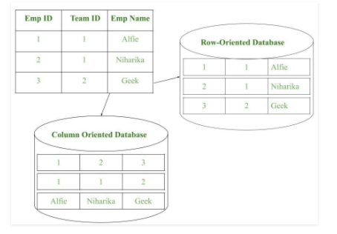
Advantages:
Data is readily available
Queries like SUM, AVERAGE, COUNT can be easily performed on columns.
Examples:
HBase
Bigtable by Google
Cassandra

Slide 17
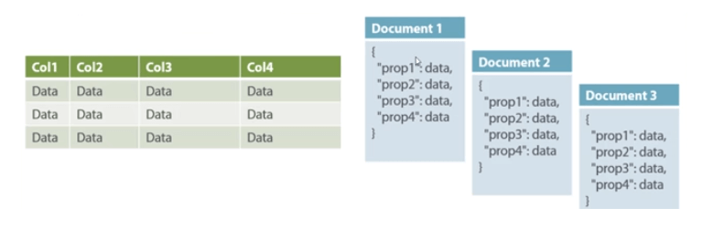
Document-Oriented:
Document-Oriented NoSQL DB stores and retrieves data as a key value pair but the value part is stored as a document.
The document is stored in JSON or XML formats.
The value is understood by the DB and can be queried.

Slide 18
3. Document Database:
The document database fetches and accumulates data in form of key-value pairs but here, the values are called as Documents.
Document can be stated as a complex data structure.
Document here can be a form of text, arrays, strings, JSON, XML or any such format.
The use of nested documents is also very common.
It is very effective as most of the data created is usually in form of JSONs and is unstructured.

Slide 19
Advantages:
This type of format is very useful and apt for semi-structured data.
Storage retrieval and managing of documents is easy.
Limitations:
Handling multiple documents is challenging
Aggregation operations may not work accurately.
Examples:
MongoDB
CouchDB

Slide 20
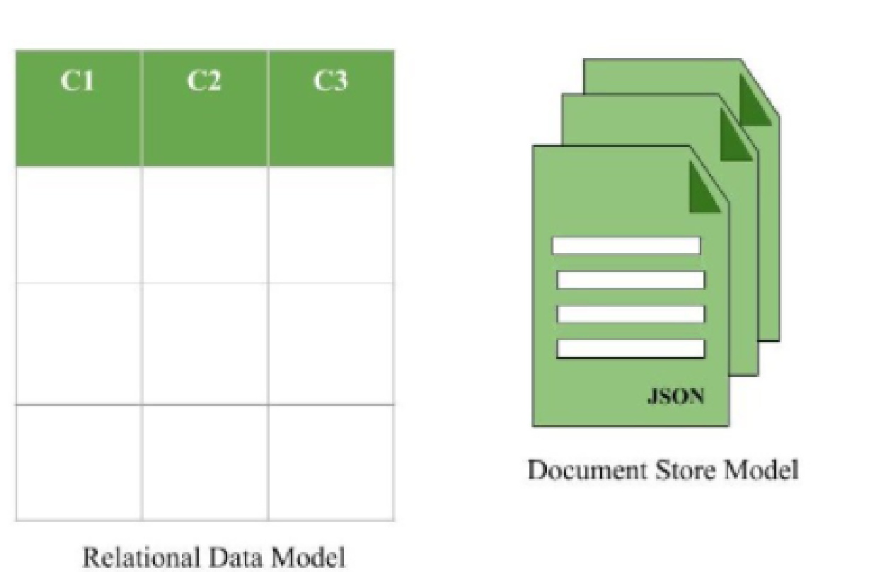

Slide 21
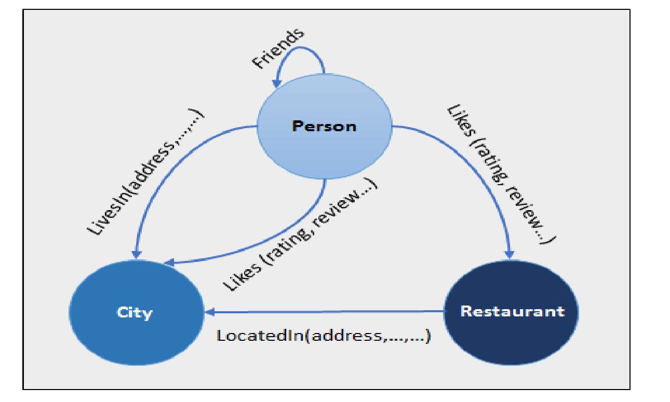
Graph-Based
A graph type database stores entities as well the relations amongst those entities.
The entity is stored as a node with the relationship as edges.
An edge gives a relationship between nodes.
Every node and edge has a unique identifier.

Slide 22
Compared to a relational database where tables are loosely connected, a Graph database is a multi-relational in nature.
Traversing relationship is fast as they are already captured into the DB, and there is no need to calculate them.
Graph base database mostly used for social networks, logistics, spatial data.
Neo4J, Infinite Graph, OrientDB, FlockDB are some popular graph-based databases.

Slide 23
4. Graph Databases:
Clearly, this architecture pattern deals with the storage and management of data in graphs.
Graphs are basically structures that depict connections between two or more objects in some data.
The objects or entities are called as nodes and are joined together by relationships called Edges.
Each edge has a unique identifier.
Each node serves as a point of contact for the graph.
This pattern is very commonly used in social networks where there are a large number of entities and each entity has one or many characteristics which are connected by edges.
The relational database pattern has tables that are loosely connected, whereas graphs are often very strong and rigid in nature.

Slide 24
Advantages:
Fastest traversal because of connections.
Spatial data can be easily handled.
Limitations:
Wrong connections may lead to infinite loops.
Examples:
Neo4J
FlockDB( Used by Twitter)

Slide 25
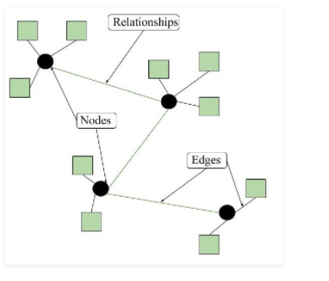
Figure – Graph model format of NoSQL Databases

Slide 26
Advantages of NoSQL
Can be used as Primary or Analytic Data Source
Big Data Capability
No Single Point of Failure
Easy Replication
No Need for Separate Caching Layer
It provides fast performance and horizontal scalability.
Can handle structured, semi-structured, and unstructured data with equal effect
Object-oriented programming which is easy to use and flexible
NoSQL databases don’t need a dedicated high-performance server

Slide 27
Support Key Developer Languages and Platforms
Simple to implement than using RDBMS
It can serve as the primary data source for online applications.
Handles big data which manages data velocity, variety, volume, and complexity
Excels at distributed database and multi-data center operations
Eliminates the need for a specific caching layer to store data
Offers a flexible schema design which can easily be altered without downtime or service disruption

Slide 28
Query Mechanism tools for NoSQL
The most common data retrieval mechanism is the REST-based retrieval of a value based on its key/ID with GET resource
Document store Database offers more difficult queries as they understand the value in a key-value pair.
For example, CouchDB allows defining views with MapReduce

Slide 29
What is the CAP Theorem?
CAP theorem is also called brewer’s theorem.
It states that is impossible for a distributed data store to offer more than two out of three guarantees
Consistency
Availability
Partition Tolerance

Slide 30
Consistency:
The data should remain consistent even after the execution of an operation.
This means once data is written, any future read request should contain that data.
For example, after updating the order status, all the clients should be able to see the same data.
Availability:
The database should always be available and responsive.
It should not have any downtime.

Slide 31
Partition Tolerance:
Partition Tolerance means that the system should continue to function even if the communication among the servers is not stable.
For example, the servers can be partitioned into multiple groups which may not communicate with each other.
Here, if part of the database is unavailable, other parts are always unaffected.

